Slide 2
Breast Cancer Screening, Risk Factors & Risk Reduction
Robina Smith, M.D. Oncoplastic Breast Surgeon

Slide 3
Overview
Breast Cancer Risk and Risk Factors
Risk Assessment Model
Choosing The Right Model for You
Risk Reduction & Prevention Strategies

Slide 4
What is cancer?
Cancer results from the accumulation of mistakes in genes that occur over many years
These mistakes are called “Mutations”.

Slide 5
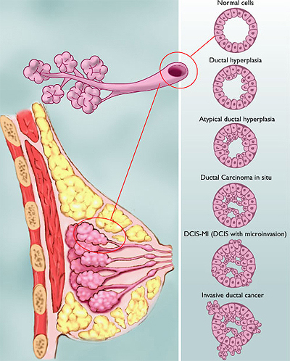
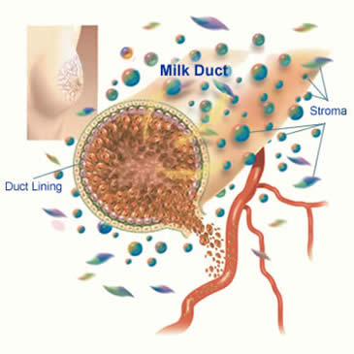
Where does cancer come from?

Slide 6
US Mortality, 2009
No. of deaths
% of all deaths
Rank
Cause of Death
1. Heart Diseases 652,486 27.2
2. Cancer 565.650 23.1
3. Cerebrovascular diseases 150,074 6.3
4. Chronic lung diseases 121,987 5.1
5. Accidents (Unintentional injuries) 112,012 4.7
6. Diabetes mellitus 73,138 3.1
7. Alzheimer disease 65,965 2.8
8. Influenza & pneumonia 59,664 2.5
9. Nephritis 42,480 1.8
10. Septicemia 33,373 1.4
Notes:
Cancer accounts for nearly one-quarter of deaths in the United States, exceeded only by heart diseases. In 2008 there were 553,888 cancer deaths in the US.

Slide 7
2009 Estimated US Cancer Deaths*
Men 294,120
Women 271,530
Lung & bronchus 31%
Prostate 9%
Colon & rectum 9%
Pancreas 6%
Leukemia 4%
Liver & intrahepatic 4% bile duct
Esophagus 4%
Urinary bladder 3%
Non-Hodgkin 3% lymphoma
Kidney 3%
All other sites 24%
26% Lung & bronchus
15% Breast
10% Colon & rectum
6% Pancreas
6% Ovary
4% Leukemia
3% Non-Hodgkin lymphoma
3% Uterine corpus
2% Brain/ONS
2% Liver & bile duct
23% All other sites
ONS=Other nervous system.
Source: American Cancer Society, 2007.
Notes:
Lung cancer is, by far, the most common fatal cancer in men (31%), followed by prostate (9%), and colon & rectum (9%). In women, lung (26%), breast (15%), and colon & rectum (10%) are the leading sites of cancer death.

Slide 8
Cancer Death Rates* by Race and Ethnicity in the US 1999-2003
Notes:
Overall, cancer death rates are higher in men than women in every racial and ethnic group. African American men and women have the highest rates of cancer mortality. Asian American and Pacific Islander men and women have the lowest cancer death rates, about half the rate of African American men and women, respectively.
Note: Rates for populations other than white and African American may be affected by problems in ascertaining race/ethnicity information from medical records. This is likely to result in reported death rates that are lower than true death rates.

Slide 9
Cancer Survival (%) by Site and Race, 1996-2002
Site
African
%
Difference
White
American
All Sites 68 57 11
Breast (female) 90 77 13
Colon 66 54 12
Esophagus 17 12 5
Leukemia 50 39 11
Non-Hodgkin lymphoma 64 56 8
Oral cavity 62 40 22
Prostate 100 98 2
Rectum 66 59 7
Urinary bladder 83 65 18
Uterine cervix 75 66 9
Uterine corpus 86 61 25
Notes:
The 5-year relative survival rate from cancer is 68% for whites and 57% for African Americans (taking normal life expectancy into consideration). For many sites, survival rates in African Americans are 10% to more than 20% lower than in whites. This is due, in part, to African Americans being less likely to receive a cancer diagnosis at an early, localized stage, when treatment can improve chances of survival. Additional factors that contribute to the survival differential include unequal access to medical care and tumor characteristics.

Slide 10
2009 Breast Cancer Statistics American Cancer Society
Females
192,370 New Diagnosis
24,000 Under 45
40,460 Breast Cancer Deaths
Males
1,910 Invasive and In Situ
450 Breast Cancer Deaths

Slide 11
The General Public’s Statistics
The death rate has decreased by 2%/yr since 1990 due to screening MMG’s.
More women are presenting at an early breast cancer stage.
2.5 million survivors in the US

Slide 12
Our Statistics!
Breast cancer is the leading cause of cancer deaths in young African American Women under 45.
By the time an African American Women turns 40, 10% will have already developed cancer.
Survival rates for African American Women are 10 – 20% lower than White women.
African American Women are less likely to receive a cancer diagnosis at an early stage.

Slide 13
Our Statistics!
African American women are more likely to present with more aggressive forms of breast cancer (i.e. triple negative). African link.
Clinical trials are research studies in which people help doctors find better ways to prevent, diagnose, or treat cancer. AAW are reluctant to participate in clinical trials for fear of being a guinea pig.

Slide 14
Lifetime Risk…..One In Eight

Slide 15
Risk of Breast Cancer Rises with Age
By age 30 1 out of 2,012 women
By age 40 1 out of 235 women
By age 50 1 out of 54 women
By age 60 1 out of 23 women
By age 70 1 out of 14 women
By age 80 1 out of 10 women
Lifetime 1 out of 8 women

