Slide 1
What would you think if I told you that YOU could prevent YOURSELF from dying from Breast Cancer?

Slide 2
The answer is…..
CANCER SCREENING!!!!!!!!

Slide 3
Specific Breast Cancer Risk Factors

Slide 4
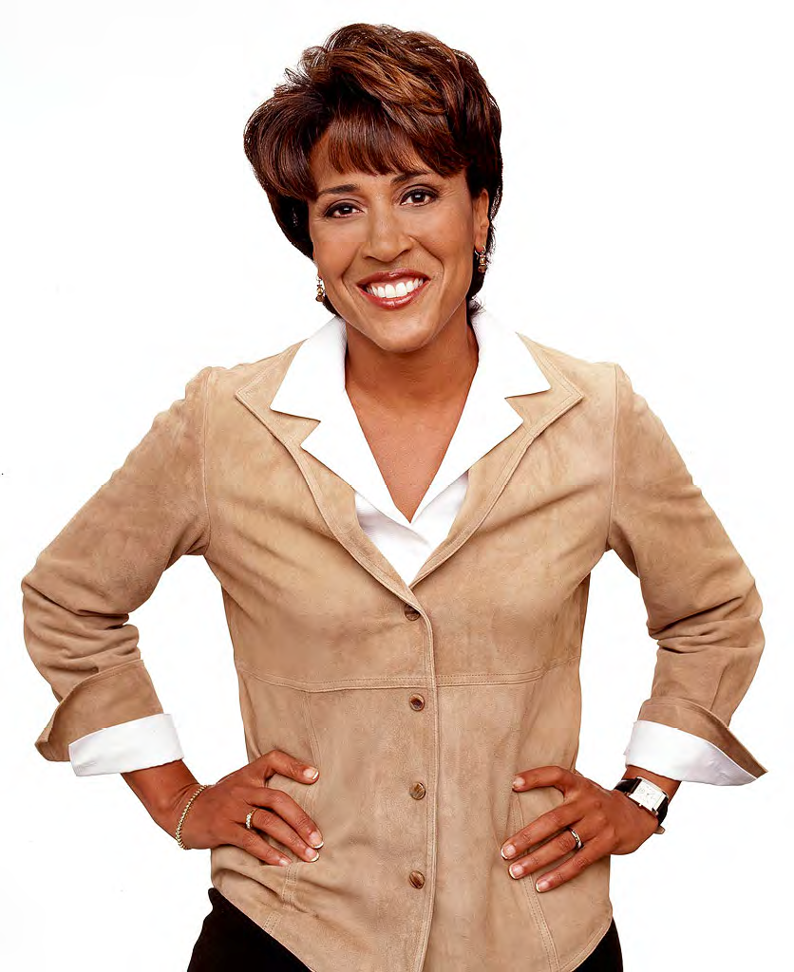
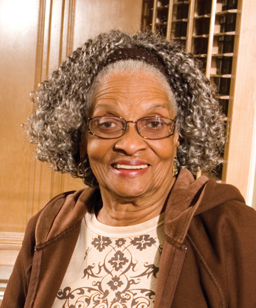
Specific Breast Cancer Risk Factors
Estrogen-Related Risk Factors
100x More Common in Women
Risk Increases with Age

Slide 5
Estrogen-Related Risk Factors
Age of Menarche <12
Increases the risk by 30%
Age of Menopause >55
Increases the risk by 50%
No children or 1st PGY >30
Increases the risk by 30%

Slide 6
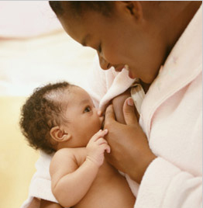
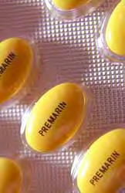
Estrogen-Related Risk Factors
Breastfeeding Decreases the risk by 4% every 12 mos of feeding
OCP prior to 1st PGY Increases the risk by .>30%
HRT > 5 yrs Increases the risk by 25%

Slide 7
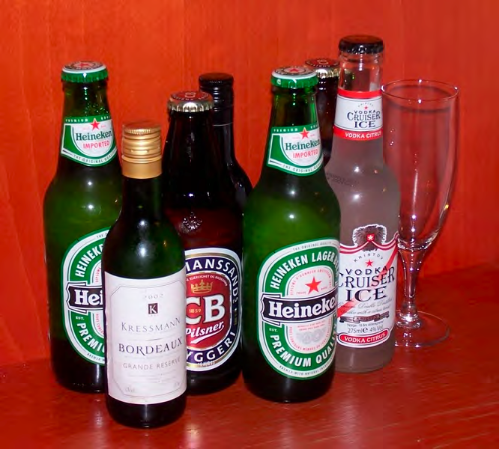
Estrogen-Related Risk Factors
Weight Gain
>33 lbs after 20 ,>24 lbs after 50
Increase risk by 60%
Drinking Alcohol
1-2 drinks/day Increases the risk by 10%
> 2 drinks/day Increases risk by 30%

Slide 8
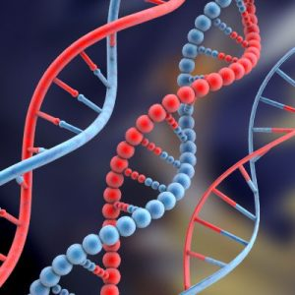
Breast Cancer Risk Factors
May be acquired
Inherited
Lifestyle
Chemicals
Radiation

Slide 9
Family History
Having a 1st Degree relative with breast cancer under 50 can increase your risk
Signs of Inherited breast cancer include having a
1st degree relative with breast cancer any age
1st degree relative with breast cancer before 50
1st degree relative with breast cancer in both breasts

Slide 10
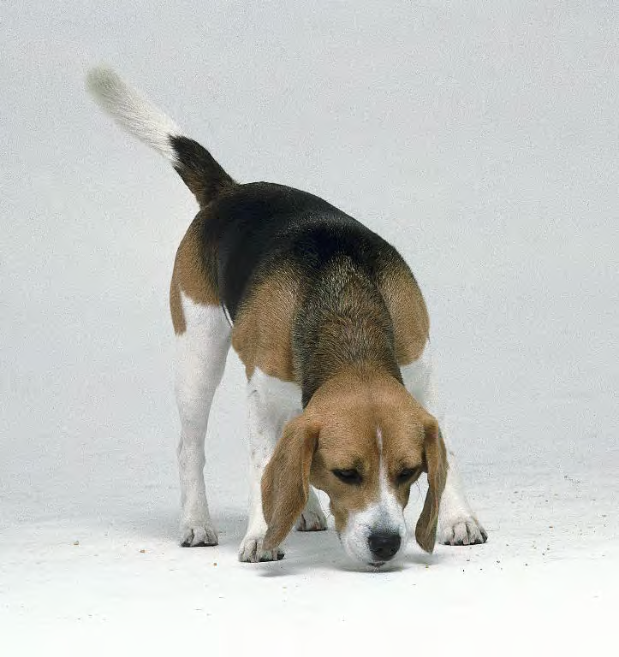
Genetic Counseling & Testing
The Clues
Cancer in multiple generations
>2 people with cancer in 1 generation
Earlier tan average age of diagnosis (<50)
Individual > 1 cancer
Cancers that run together (breast and ovarian)
Male breast cancer

Slide 11
Hereditary Breast Cancers BRCA 1 and BRCA 2
Breast cancer – 50-85% lifetime risk
Second breast cancer – 40-60% lifetime risk
Ovarian cancer – 15-45% lifetime risk
6% risk for Male breast cancer (BRCA2) (increased risk for Prostate, Pancreas, Melanoma)

Slide 12
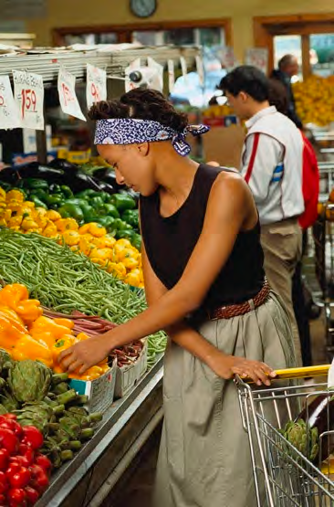
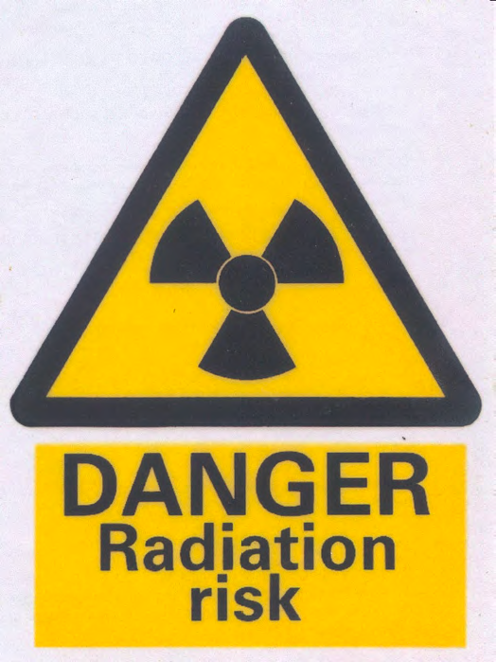
Environmental Risk Factors
Smoking
MMG are safe
Pesticides

Slide 13
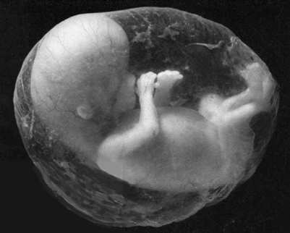
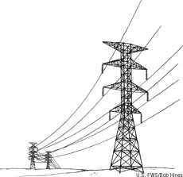
These are not Risk Factors
Implants
Underwire
Acrylamides
Abortion
Electromagnetic XRT
Deodorant

Slide 14
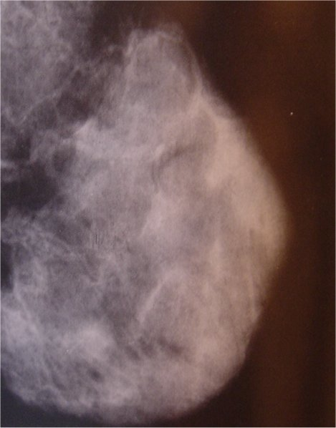
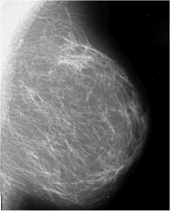
Personal Risk Factors
Dense breast tissue
Increases risk >80%
Previous breast biopsies with benign breast disease such as
LCIS ( X 5-11 )
ADH ( X 4 )
ALH ( X 4-5 )
Dense Breast
Glandular & Stroma >> Fat
Fatty Breast
Fat >> Glandular & Stoma

Slide 15
Environmental Risk Factors: Lifestyle Choices
5 A Day
Eating 5 Fruits and Vegetables a day decreases risk by 36%
Especially Cruciferous vegetables: arugula, broccoli, cabbage, cauliflower,
Brussel sprouts, turnip/mustard greens, bok choy, Rutabaga, Napa, Kale, etc.

Slide 16
Environmental Risk Factors: Lifestyle Choices
Exercising 1-1/4 to 2-1/2 hours/week Decreases risk by 18%
> 4 hours/week decreases risk by 40%

